Slide 1


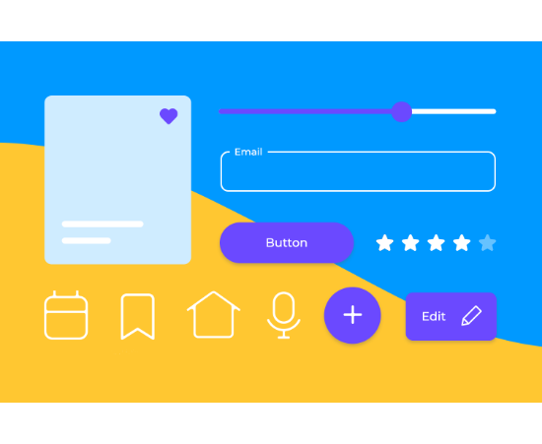
Introduction to CSS
CSS stands for Cascading Style Sheets.
It controls how a webpage looks: colors, fonts, layouts, spacing, and more.
HTML builds the structure, CSS makes it beautiful.

Slide 2




Quiz Time!
What does CSS mainly control in a website?
B) Styling

Slide 3

Quiz Time!
What does CSS mainly control in a website?

Slide 4
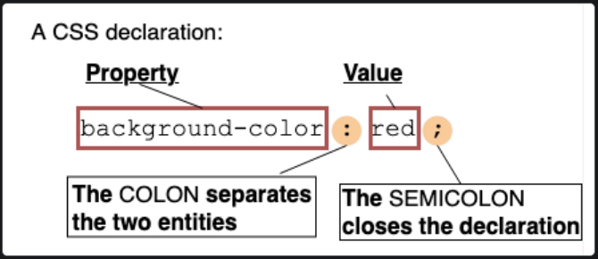

CSS Syntax Overview
A CSS rule has 3 main parts:
Selector (chooses the element)
Property (what you want to change)
Value (the change you apply)
p
{
color
red
:
;
}

Slide 5

Coding Challenge
Write CSS to make all titles blue.
h1
{
color
:
blue
;
}

Slide 6
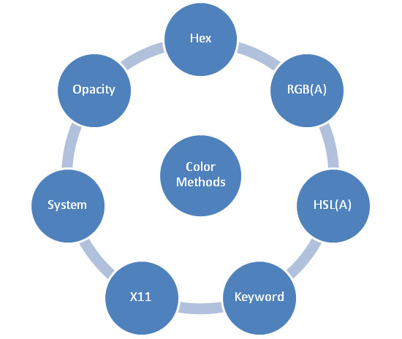
Color Types in CSS
CSS supports multiple ways to define colors:
Names (e.g., red, blue)
HEX (e.g., #ff0000)
RGB (e.g., rgb(255, 0, 0))

Slide 7
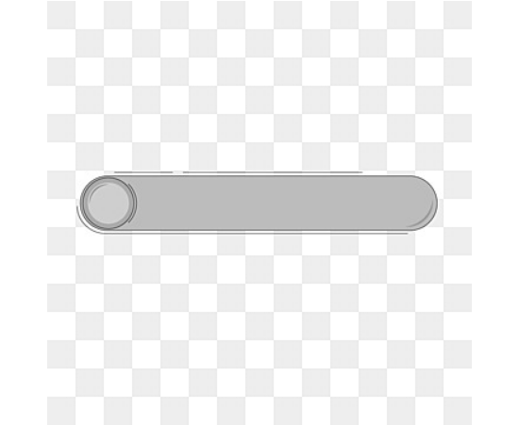
Coding Challenge
Change a paragraph background to light gray.
p
{
background-color
lightgray
:
;
}

Slide 8
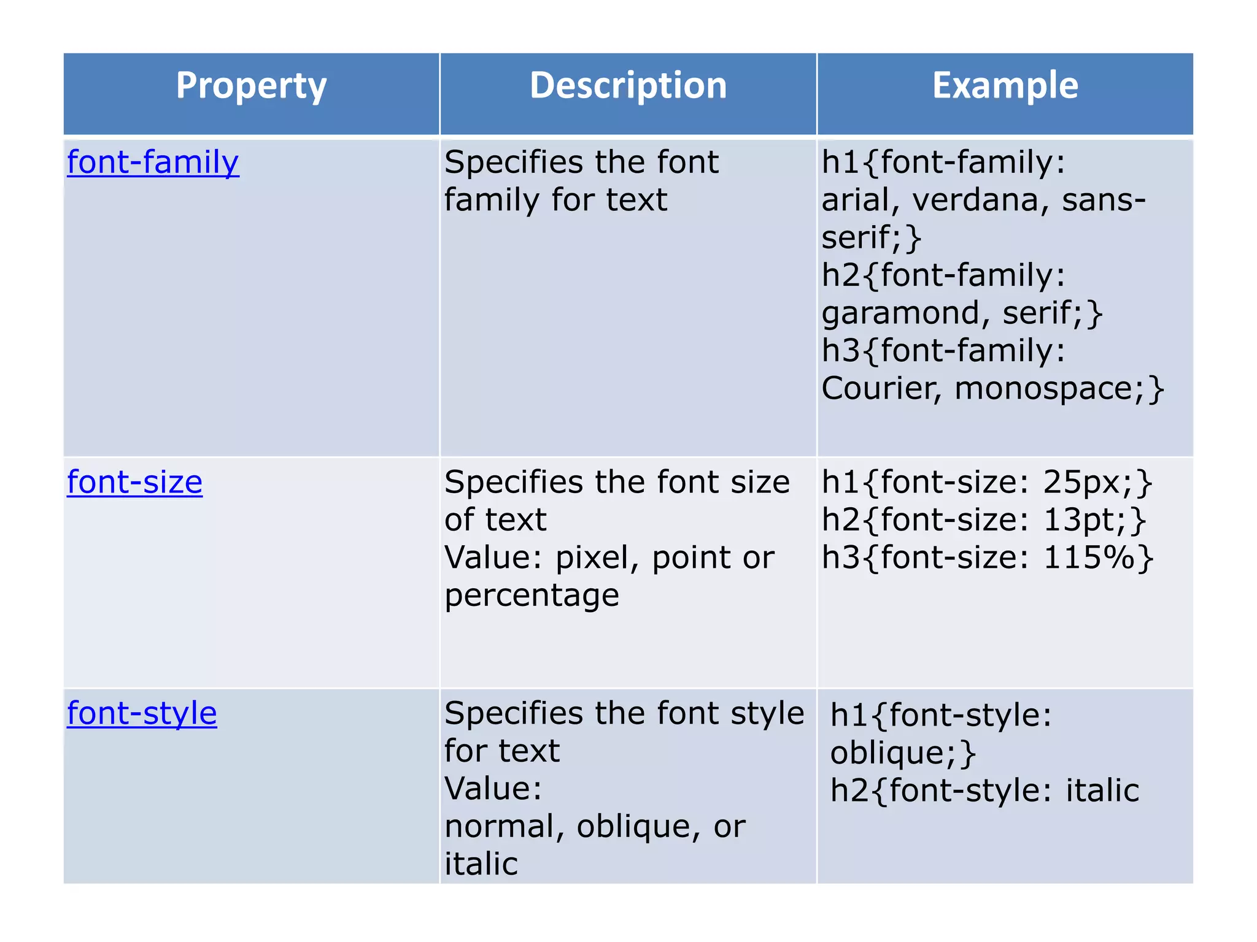

Font Basics
Common font properties:
font-size (size of text)
font-family (typeface)
font-weight (boldness)
font-style (italic, etc.)
p
{
font-size
:
20px
;
}

Slide 9


Quiz Time!
Which CSS property changes the text size?
B) font-size

Slide 10

Quiz Time!
Which CSS property changes the text size?

Slide 11
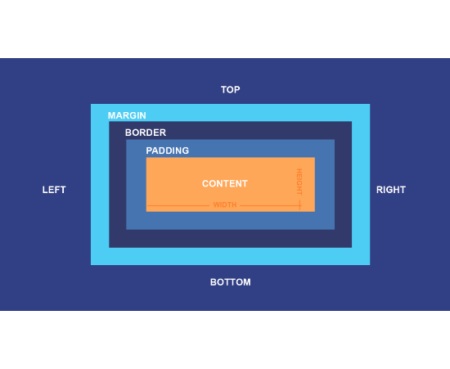
Margins & Padding
Understanding spacing is crucial:
Margin = Space outside the element (pushes others away).
Padding = Space inside the element (pushes content inward).

Slide 12
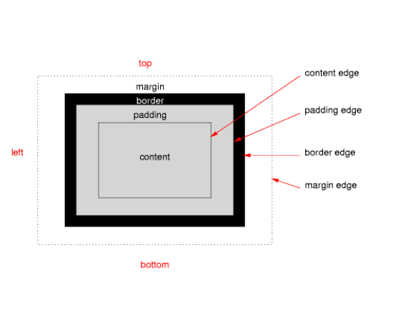
Coding Challenge
Add 20px padding to a div.
div
{
padding
20px
:
;
}

Slide 13
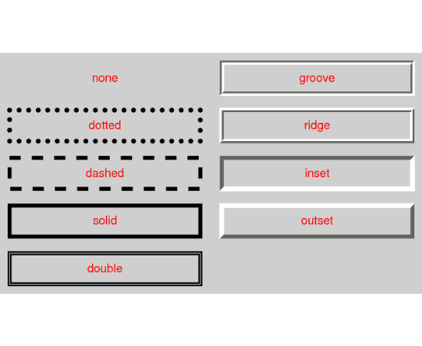
Borders Overview
You can style borders with three main properties:
border-width (how thick)
border-style (solid, dotted, dashed)
border-color (the color)

Slide 14
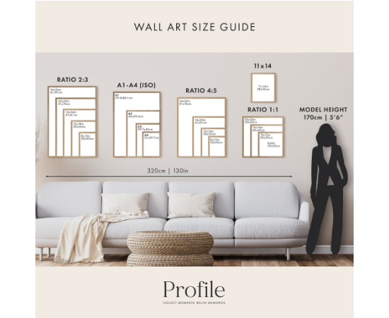



Quiz Time!
Which one is NOT a border style?
C) invisible

Slide 15

Quiz Time!
Which one is NOT a border style?

Slide 16
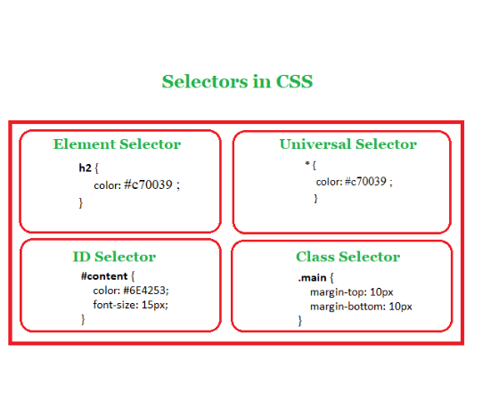
Basic CSS Selectors
How to target elements:
Element selector (e.g., p, h1)
Class selector (starts with . e.g., .box)
ID selector (starts with # e.g., #header)

Slide 17
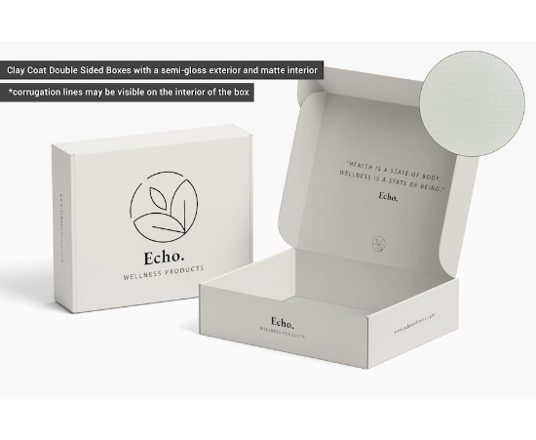
Coding Challenge
Style a class called "box" to be 100px wide.
.box
{
width
:
100px
;
}

Slide 18
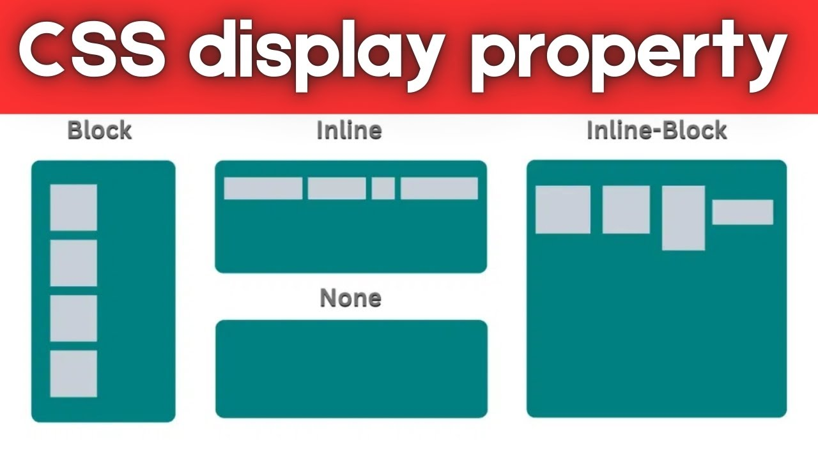
CSS Display Types
Control how elements sit on the page:
block (Starts on a new line, full width)
inline (Sits on the same line, like text)
inline-block (Same line, but respects width/height)

Slide 19
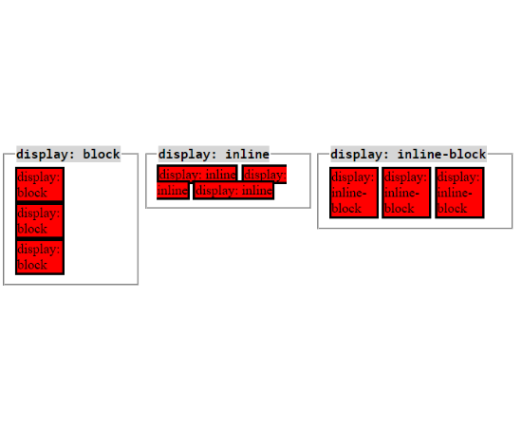


Quiz Time!
Which display makes an element start on a new line?
B) block

Slide 20

Quiz Time!
Which display makes an element start on a new line?

Slide 21
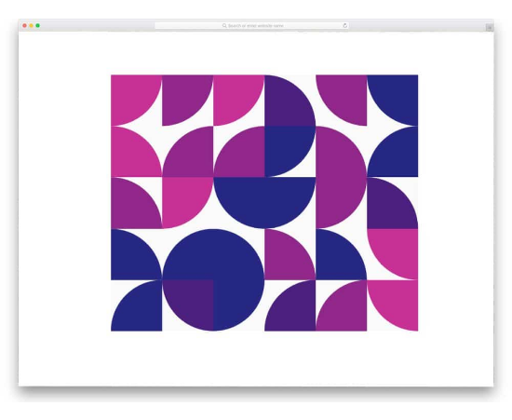
Background Properties
More than just colors:
background-color (Fill color)
background-image (Use an image URL)
background-size (Control how the image fits)

Slide 22
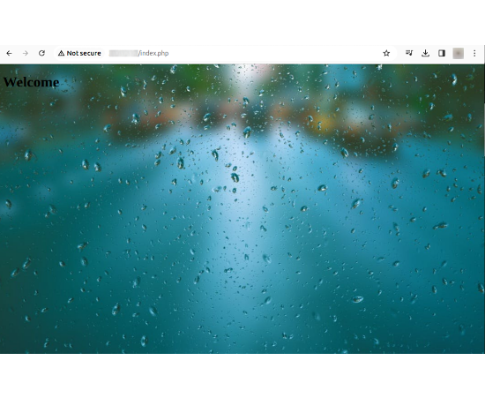
Coding Challenge
Set a background image for the body.
body
{
background-image
:
url('bg.png')
;
}

Slide 23
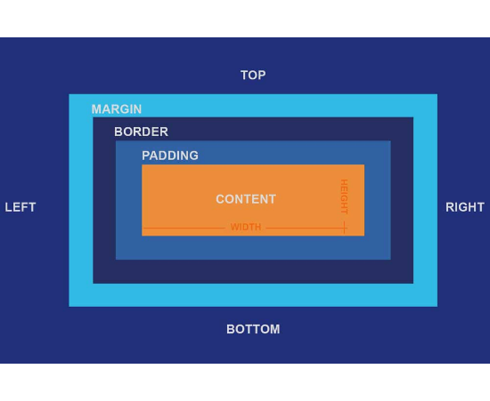
The Box Model
Every element is a box composed of:
Content (The actual text/image)
Padding (Space around content)
Border (Around padding)
Margin (Space outside border)

Slide 24



Quiz Time!
Which part is inside the padding?
B) Content

Slide 25

Quiz Time!
Which part is inside the padding?

Slide 26
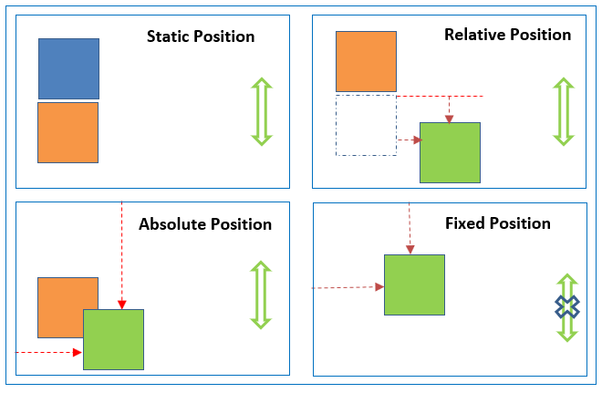
Position Types
CSS positioning determines placement:
static (Default)
relative (Relative to normal position)
absolute (Relative to nearest positioned ancestor)
fixed (Relative to the viewport)

Slide 27
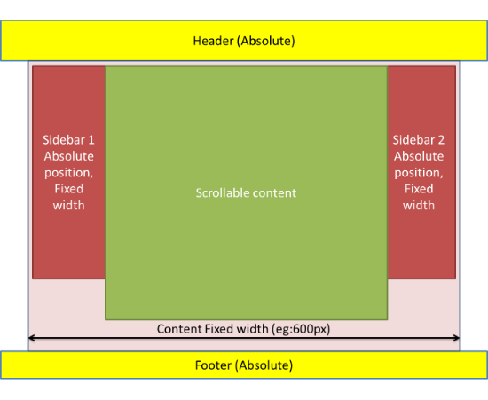

Coding Challenge
Make a div fixed at the top.
div
{
position
:
;
fixed
top
:
0
;
}

Slide 28
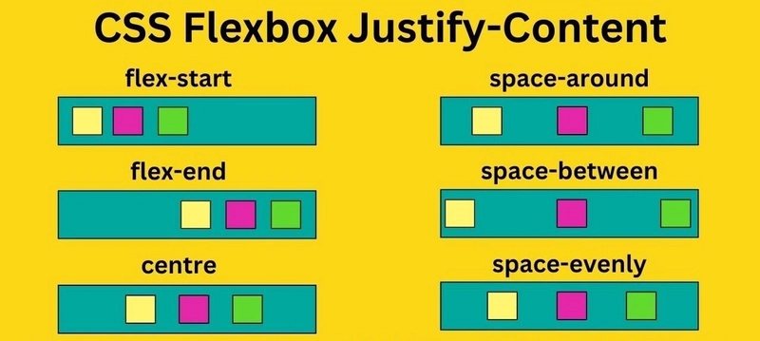
What Is Flexbox?
A layout model that helps align items easily.
display: flex (Enables flexbox)
justify-content (Aligns horizontally/main axis)
align-items (Aligns vertically/cross axis)

Slide 29

Quiz Time!
Which property centers items horizontally?
B) justify-content

Slide 30

Quiz Time!
Which property centers items horizontally?

Slide 31
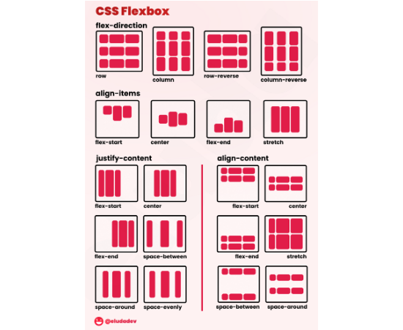

Flexbox Practice
Center all items inside a container horizontally.
.container
{
display
:
flex
;
justify-content
:
center
;
}

Slide 32
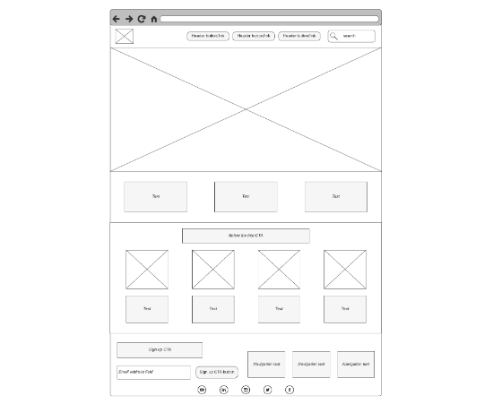


Quiz Time!
Flexbox is mainly used for:
B) Page layout

Slide 33

Quiz Time!
Flexbox is mainly used for:

Slide 34
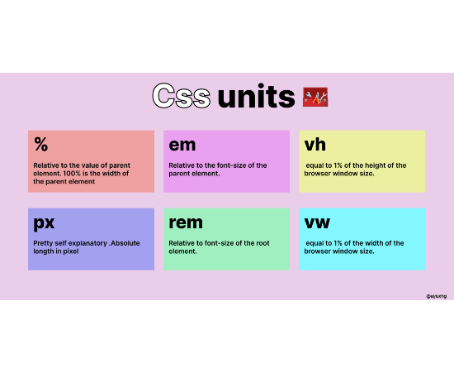
CSS Units
Commonly used units for sizing:
px (pixels, fixed)
% (percentage, relative)
em / rem (relative to font size)
vh / vw (viewport height/width)

Slide 35
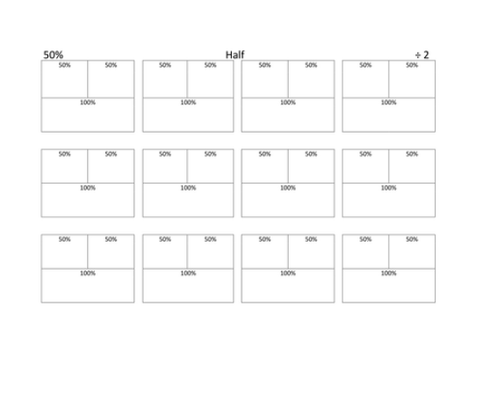
Coding Challenge
Make a box width 50% of the screen.
.box
{
width
:
50%
;
}

Slide 36

Quick Revision
We have covered:
Syntax
Display
Colors & Fonts
Backgrounds
Margin & Padding
Box Model
Borders
Flexbox
Selectors
Units

Slide 37
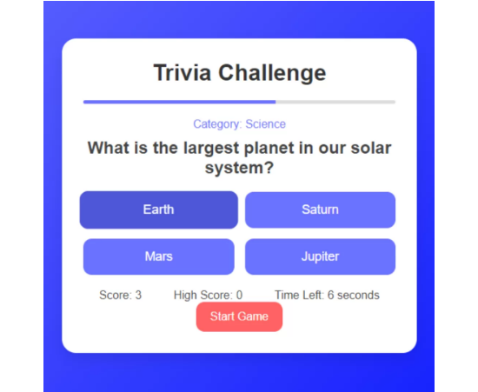


Final Quiz
Which CSS selector refers to a class?
B) .card

Slide 38

Final Quiz
Which CSS selector refers to a class?

Slide 39
Thank you

